Slide 1
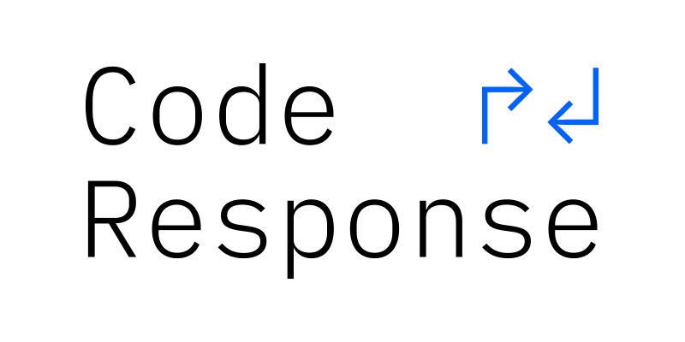
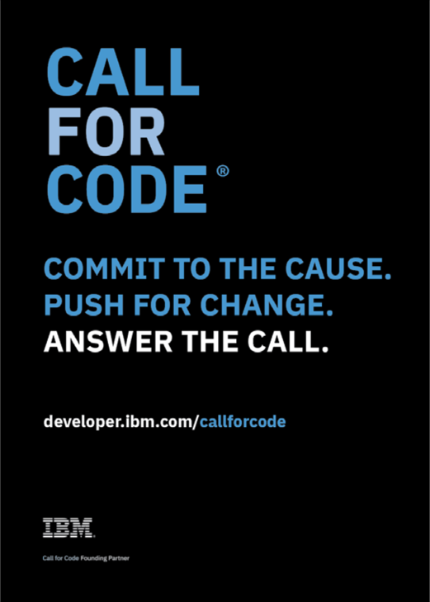

Slide 2
CALL FOR CODE DAY – Workshop Agenda
Disasters Prone to happen
Coding for a cause - CALL FOR CODE, solving real world challenges through technology
Call for code Registration
Technology Outlook – Cloud , AI and IoT Services
Solution to Problems
Application architecture flow based on IoT, Weather, Blockchain , AI
Hands On
Ideation – Team to present
Judging
Top 2 ideas

Slide 3
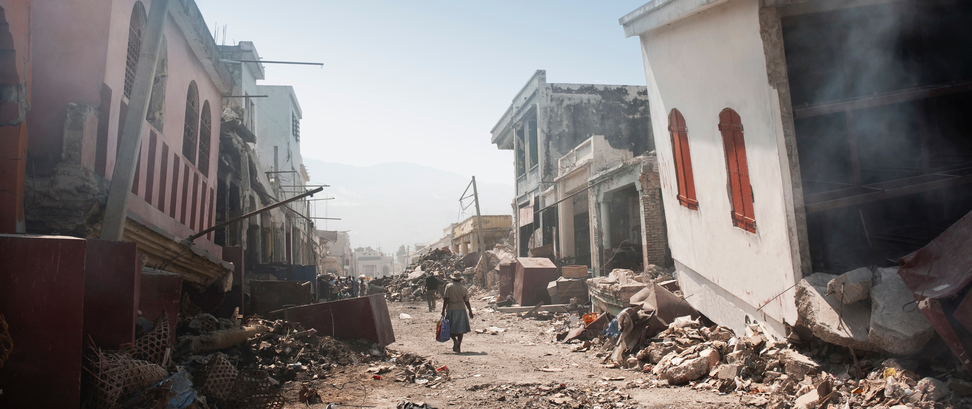
Natural disasters are among the world’s greatest challenges…
800,000+
worldwide deaths attributed to earthquakes since 2010
17 million
acres lost to wildfire in the United States in the last 2 years
25%
coastline areas that met or surpassed record number of flood days
22
named storms in the Eastern Pacific region this year – a record
800+
confirmed tornadoes touched down in 2018
18
volcanos considered a “very high threat” in the U.S. alone

Slide 4
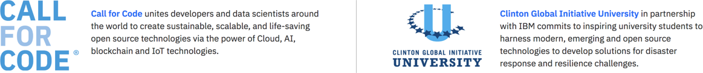
Code and Response is an IBM initiative which provides a platform to create and deploy open source technologies to tackle some of the world’s biggest challenges.
Coding challenges: Call for Code, Clinton Global Initiative University-affiliated codeathons, IBM BlueHacks and more.
Solution deployment: Starting with the testing and implementation of Call for Code winner, Project Owl.
Volunteer programs: Working with volunteers to help in disaster relief efforts with the American Red Cross and other partners.
Learn more about Code and Response: developer.ibm.com/code-and-response
Notes:
IBM announced the C&R initiative at our flagship event in San Francisco in February. Our CEO and Chairman, Ginni Rometty announced this as part of her keynote to open the conference.
Over the next four years IBM is investing to provide a platform for inspiring tech for good, specifically addressing the challenges faced when a natural disaster occurs.
This platform will create and deploy open source technologies in communities where they are needed most, to tackle some of the world’s biggest challenges. Because of our history with Open Source communities, we are uniquely positioned to work alongside ecosystem partners to actively host and maintain solutions with the key communities, in particular The Linux Foundation is partnering with us on the coding challenges to ensure sustainable, quality projects. (This is a differentiator for our challenges in C&R compared to the challenges out there).
So what is C&R? It is made up of 3 parts, which when combined deliver the social impact needed to make a difference in the world by putting technology first.
Coding challenges
Solution deployment
Volunteer programs
IBM is uniquely positioned to work with the American Red Cross, CGI U and others to provide the resources to build, fortify, test, and implement solutions at scale.

Slide 5
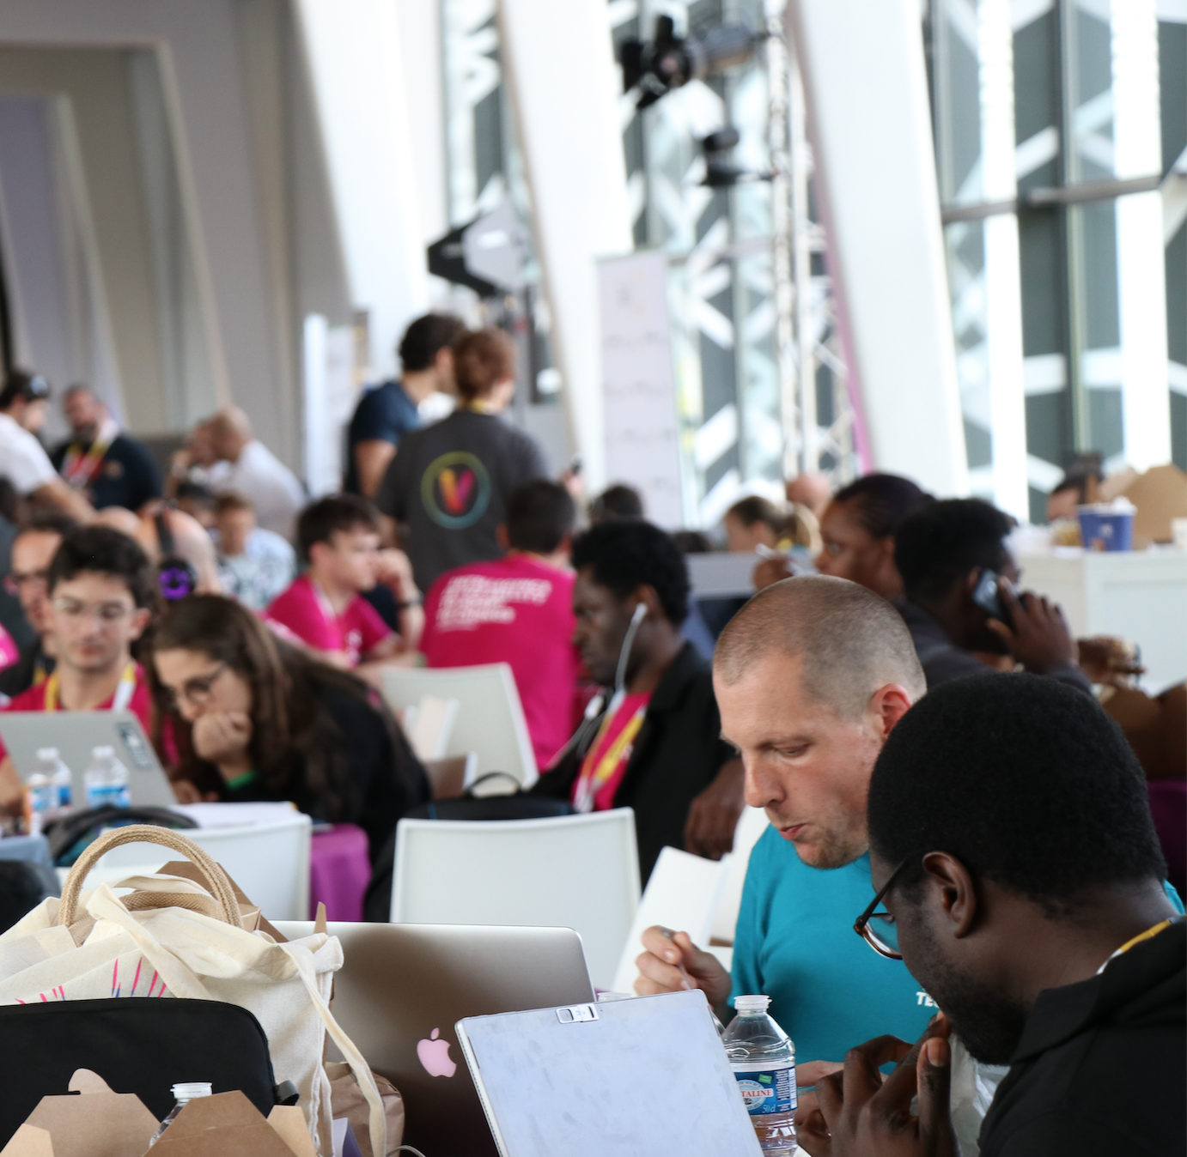
RESPONDING TO THE CALL
Call for Code Day
Today !
Full day hackathon with IBM Developer Advocates. Teams to work on projects and prepare a project overview for judging.
Submit Projects
Competition deadline 7/29
Take feedback from peers, judges and IBM SME. Continue to improve projects for submission to the challenge.
*Asterisk indicates Platinum benefit only

Slide 6
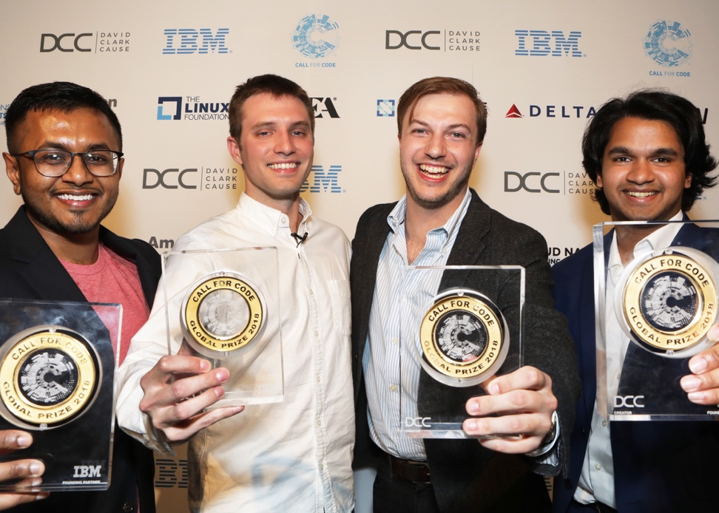
2018
1 Grand Prize Winner Project Owl
156 Nations contributed
100k+ Developers participated
2,500+ Applications created
400+ Call for Code days across the world
40+ Celebrity supporters
The prize structure inspired and nurtured the winning idea with 5 awards to attract and implement sustainable solutions
PROJECT OWL
Keeping first responders and victims connected after a natural disaster
Eminent Call for Code award Large cash prize Venture capital investment introduction Open source project support On-the-ground pilot deployment support
IoT approach integrates IBM Watson Studio, Watson Cloud APIs, and Weather Company APIs on the IBM Cloud

Slide 7
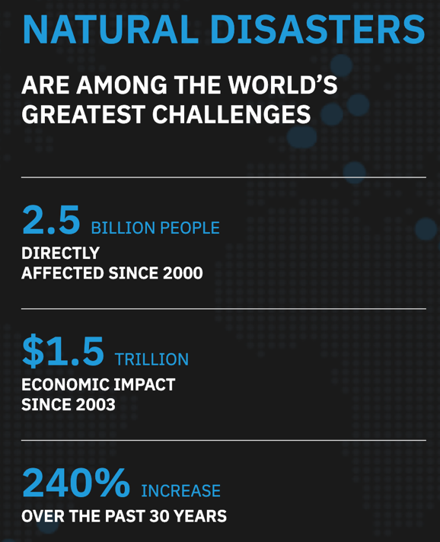
Call for Code 2019 Global Challenge Overview
What is it?
Creating practical, effective, and high-quality applications using technology that has an immediate and lasting impact on humanitarian issues.
Build solutions that significantly improve preparedness for natural disasters and accelerate relief when they hit.
This year’s challenge also introduces an emphasis on individual health and community well-being.
Top prize of $200k, support from The Linux Foundation, Code and Response™ solution implementation, and more!
Submissions open until July 29th, winners announced in October
Call for Code days and Hackathon events throughout the submission dates
Notes:
Call for Code 2018 Stats
100,000 developers
156 countries
2,500+ applications
60 organizational supporters
2.5 billion people reached
What is it?
Creating practical, effective, and high-quality applications
Cloud, data, and artificial intelligence, etc.
This year’s challenge
This includes solutions that can reduce the risk of disease, improve access to data and the availability of resources, and address the mental health needs of those impacted before, during, and after disasters.
Prizes
Grand Prize
$200k cash prize
Invitation to the Call for Code Global Prize Celebration
Open source project support from The Linux Foundation
Opportunity for mentorship and investment in the solution
Solution implementation support through Code and Response™
First and Second Runner Up
$25k cash prize
Invitation to the Call for Code Global Prize Celebration
Open source project support from The Linux Foundation
Third and Fourth Runner Up
$10k cash prize
Invitation to the Call for Code Global Prize Celebration
Long-term open source project support from The Linux Foundation

Slide 8

Commit to the Cause, Push for Change
Build a cloud, data, analytics, AI, IoT, or blockchain solution to improve natural disaster preparedness, response, or recovery focused on the health and well-being of individuals and communities.
Potential problem areas
Reduce vulnerability by managing disaster risk over the long run
Forecast impending threats to improve preparation in the short term
Respond to medical needs during the disaster
Improve the resiliency of communities to restore health services after
Potential solutions
Alert pharmacies to increase stocks of antibiotics, insulin, water, and vaccines based on predicted weather-related disruptions.
Use analytics to predict the impact of disasters and educate communities on how to prepare for impending threats.
Use visual recognition to assess the impact of a disaster and accelerate response, reducing time to build back better.
Improve the efficiency, accountability, and resiliency of supply chains through blockchain technology.

Slide 9

Call for Code 2019 Overall Schedule
Call for Code
challenge issued
February 12
Call for Code
challenge opens
March 25
Submission
deadline
July 29
Winners are
announced
October
MOU Signed
April 15
Judging begins
August
Notes:
What we do
Technical Pre-enablement
briefings, workshops, digital content
Technical expertise
Mentors
They do
Provide space
Provide logo for advertising
Bring developers

Slide 10
KEY RULES
ACCEPT THE PARTICIPATION AGREEMENT
All team members must have accepted the 2019 Participation Agreement at the time they submit to be eligible.
COMPETE ALONE OR AS PART OF A TEAM
Teams of up to five (5) participants, each at least 18 years old, are allowed.
A participant may not be part of multiple teams.
USE THE IBM CLOUD
Submissions must use one or more IBM Cloud services or IBM Systems. Use of sponsor or affiliate APIs and open source libraries is also encouraged.
Applications must be new and built for the 2019 competition, but they may use code that was open sourced and publicly available to all other participants as of February 12, 2019.
Winning teams will be subject to a code review after submissions close.

Slide 11

JUDGING
5 POINTS FOR EACH (20 TOTAL)
COMPLETENESS AND TRANSFERABILITY
How fully has the idea been implemented? Can it achieve an impact in the field? Can it be transferred elsewhere?
EFFECTIVENESS AND EFFICIENCY
Does the solution address a high priority area? Does it achieve its goal effectively and efficiently? Can it scale?
DESIGN AND USABILITY
How good is the design, user experience, and ease of use of the solution? How quickly can it be put to use?
CREATIVITY AND INNOVATION
How unique was the approach to solving a long-standing or previously intractable problem?

Slide 12
Build and submit your solution for natural disaster preparation, response, and recovery
https://developer.ibm.com/callforcode/
2019
STEP 1:
JOIN THE CALL FOR CODE 2019 CHALLENGE COMMUNITY
STEP 2:
EXPLORE RESOURCES AND BUILD WITH CODE PATTERNS
STEP 3:
LEARN FROM EXPERTS AND FIND TEAMMATES
STEP 4:
SUBMIT (AND ITERATE ON) YOUR 2019 CALL FOR CODE SOLUTION
LEARN ABOUT THE COMPETITION SCOPE, PRIZES, RULES, AND SCHEDULE
USE CODE PATTERNS TAILORED TO YOUR INDUSTRY AND DIGITAL KITS TO RUN AN EVENT
INTRODUCE YOURSELF, MEET ADVOCATES, BRAINSTORM IDEAS, FIND A TEAM, HEAR ABOUT UPDATES
DESCRIBE YOUR SOLUTION, LINK TO YOUR CODE AND DEMO, ACCEPT THE PARTICIPATION AGREEMENT

Slide 13
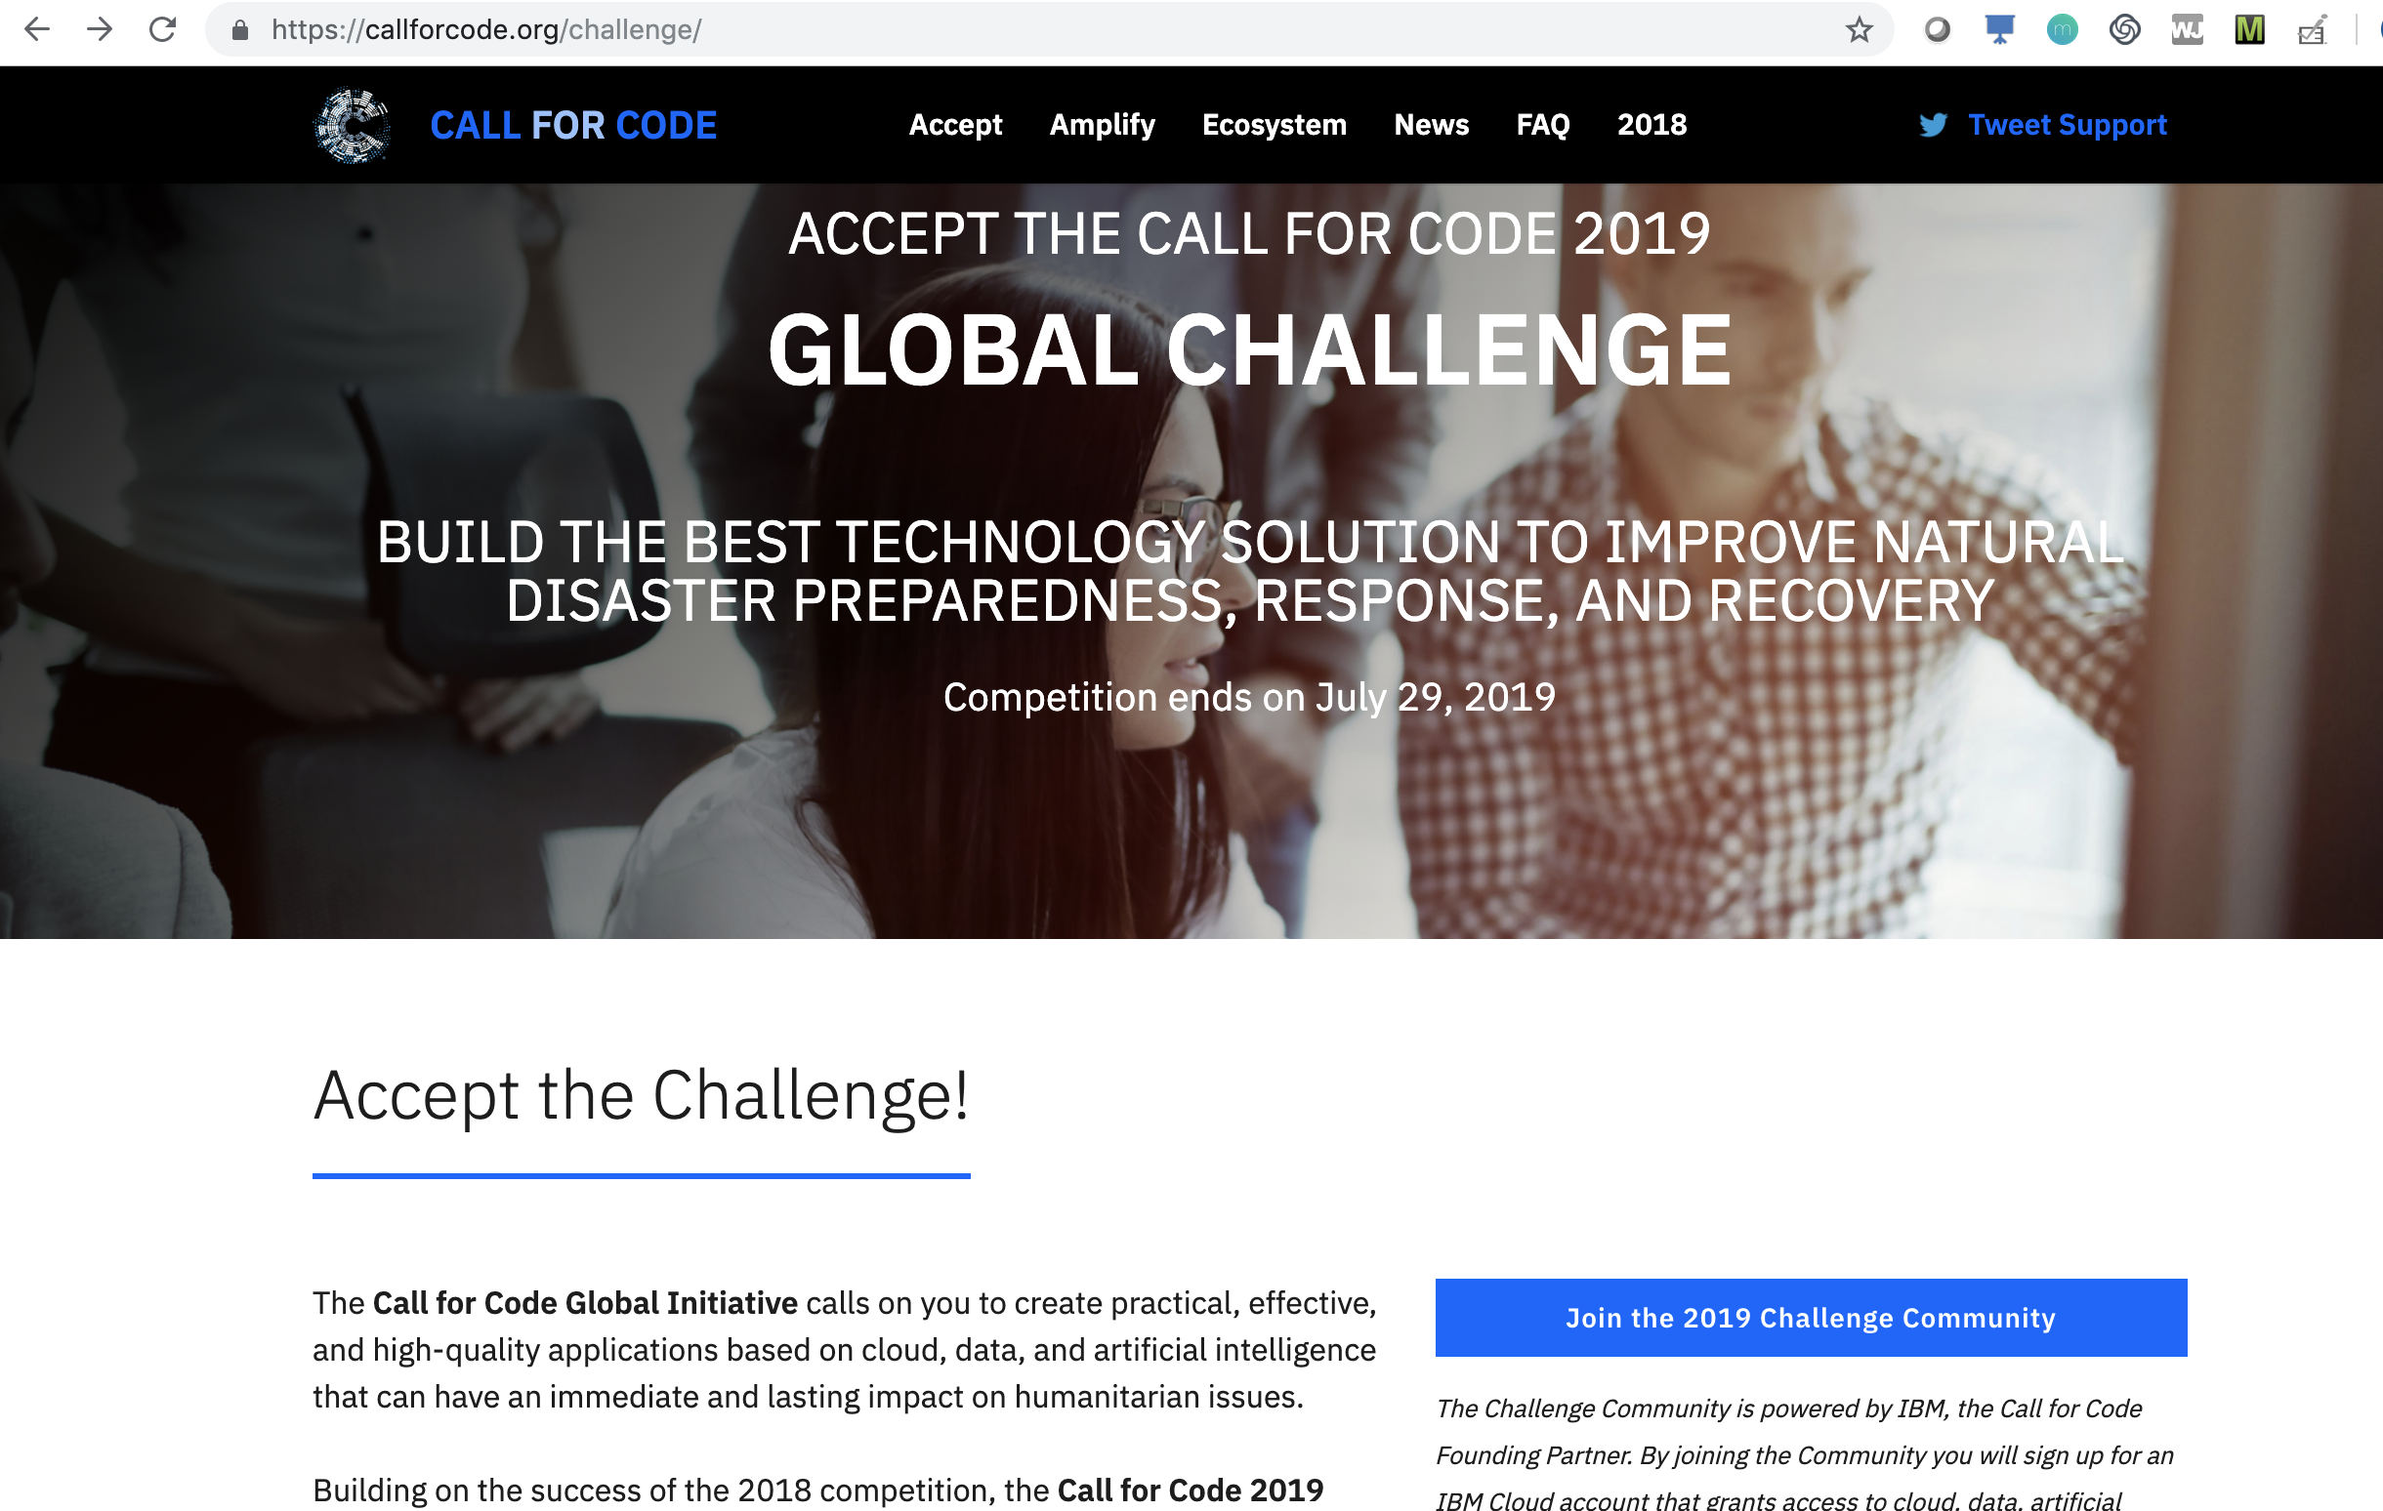
STEP 1:
JOIN THE CALL FOR CODE 2019 CHALLENGE COMMUNITY
https://callforcode.org
LEARN ABOUT THE COMPETITION SCOPE, PRIZES, RULES, AND SCHEDULE
Notes:
The first step is to go to callforcode.org and learn about the challenge and get registered.
That will give you pointers to sign up for an IBM account, and get access to the various tools that IBM has put in place to get your coding, teaming, and submissions going.
You’ll want to continue to come back to this site to hear about the latest partners that have joined, as well as the expanding list of judges as they are announced.
You’ll get an invite to Slack after registering, but if not, let one of us know and we can hook it up. That’s how you can work with us during and after this event.

Slide 14
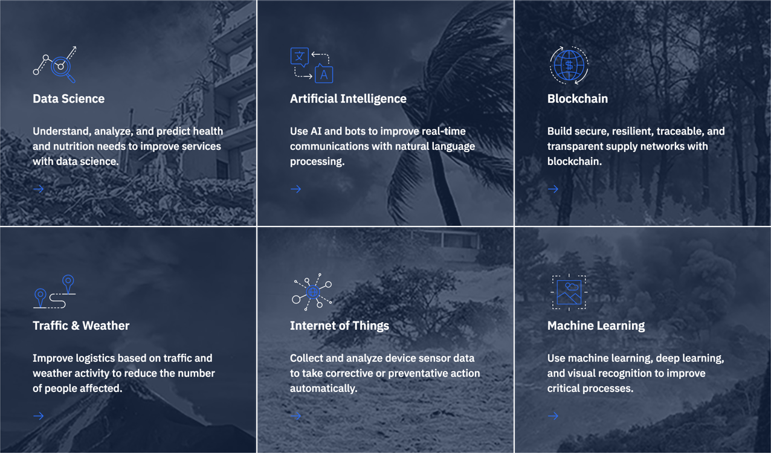
STEP 2:
EXPLORE RESOURCES AND BUILD WITH CODE PATTERNS
https://developer.ibm.com/callforcode/#tech-areas
USE CODE PATTERNS TAILORED TO YOUR INDUSTRY AND DIGITAL KITS TO RUN AN EVENT
Notes:
Within this site you’ll also find a growing set of starter applications, blogs, how-tos, and tech talks that bridge the challenge scope and priorities defined by the NGOs with the IBM technology that you can use to inspire or kickstart your application.

Slide 15
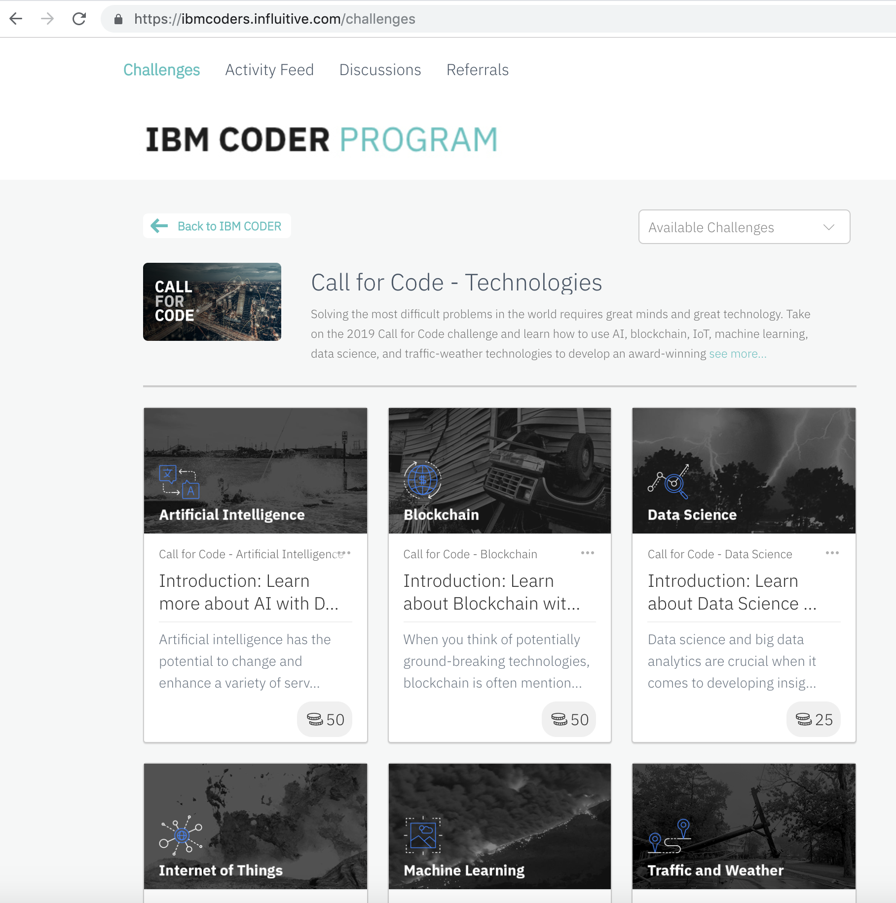
STEP 3:
LEARN FROM EXPERTS AND FIND TEAMMATES
ENGAGE THE COMMUNITY https://ibmcoders.influitive.com
INTRODUCE YOURSELF, MEET ADVOCATES, BRAINSTORM IDEAS, FIND A TEAM, HEAR ABOUT UPDATES
Notes:
When you sign up for an IBM Cloud account, you’ll also have access to the IBM Coder community, where you can explore each of the technology areas, join discussion forums.

Slide 16
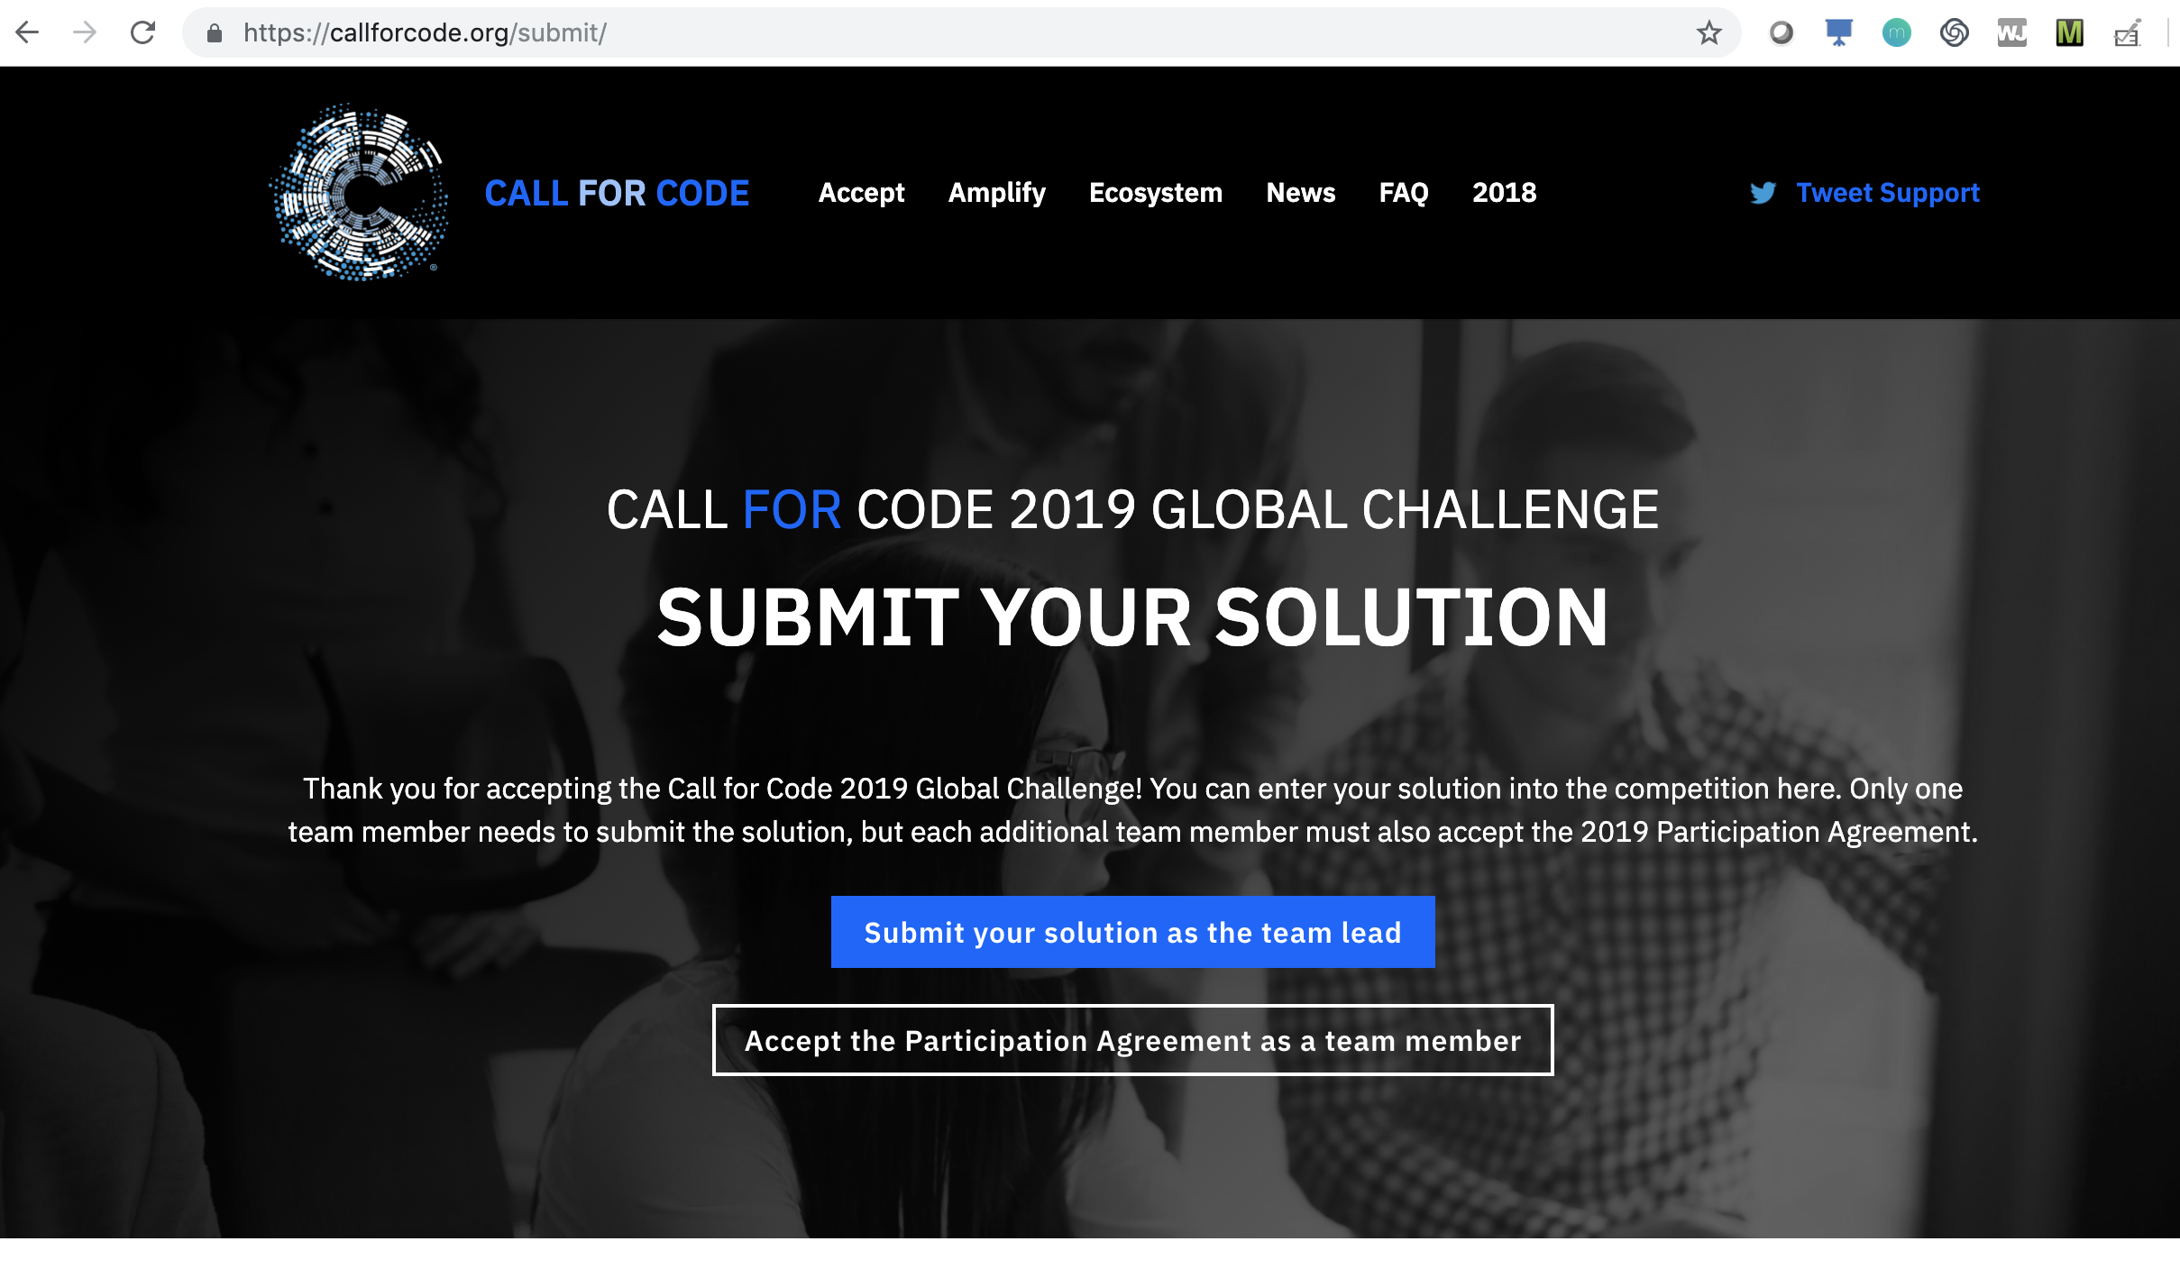
STEP 4:
SUBMIT YOUR APPLICATION TO ENTER THE COMPETITION
https://callforcode.org/submit/
DEFINE YOUR TEAM NAME AND TEAM MEMBERS.
DESCRIBE YOUR SOLUTION, UPLOAD YOUR DEMO, AND LINK TO YOUR REPO.

Slide 17
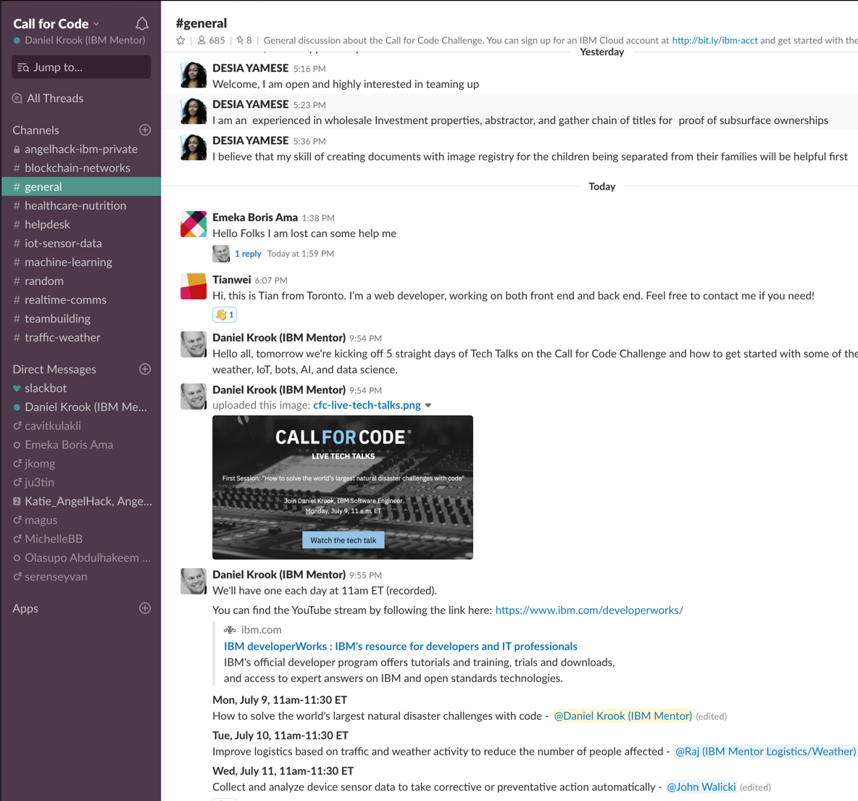
ENGAGE THE COMMUNITY
After registration, look for an email with a subject of Global Call for Code Submission Details and more.
Join CFC Slack = http://callforcode.org/slack
Notes:
When you register for the challenge, you’ll also be invited to the Slack community, where you can explore each of the technology areas, join discussion channels.

Slide 18
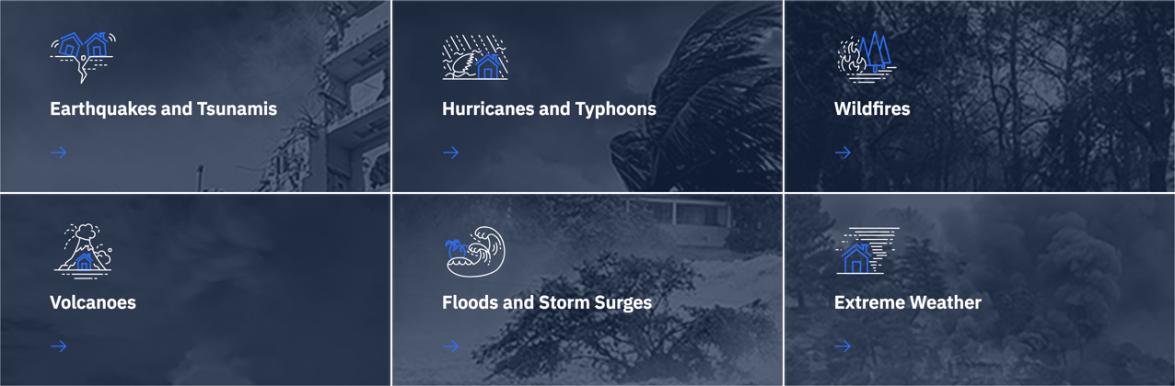
Explore types of disasters and how we can lessen their effects through technology
https://developer.ibm.com/code-and-response/disasters/
Notes:
To give participants a starting point, we’ve mapped IBM technology to those identified needs in six areas. They act as bridges between the developer and the NGO frameworks, but are not a rigid structure for submissions.
Those code patterns fall into 6 problem domains you can explore. You’re not limited to solving problems in these areas, but you can use them to inspire whatever you build

Slide 19
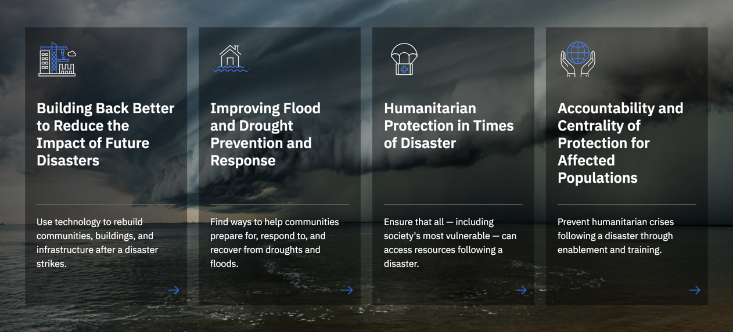
Solution Starters
https://developer.ibm.com/callforcode/starters/

Slide 20
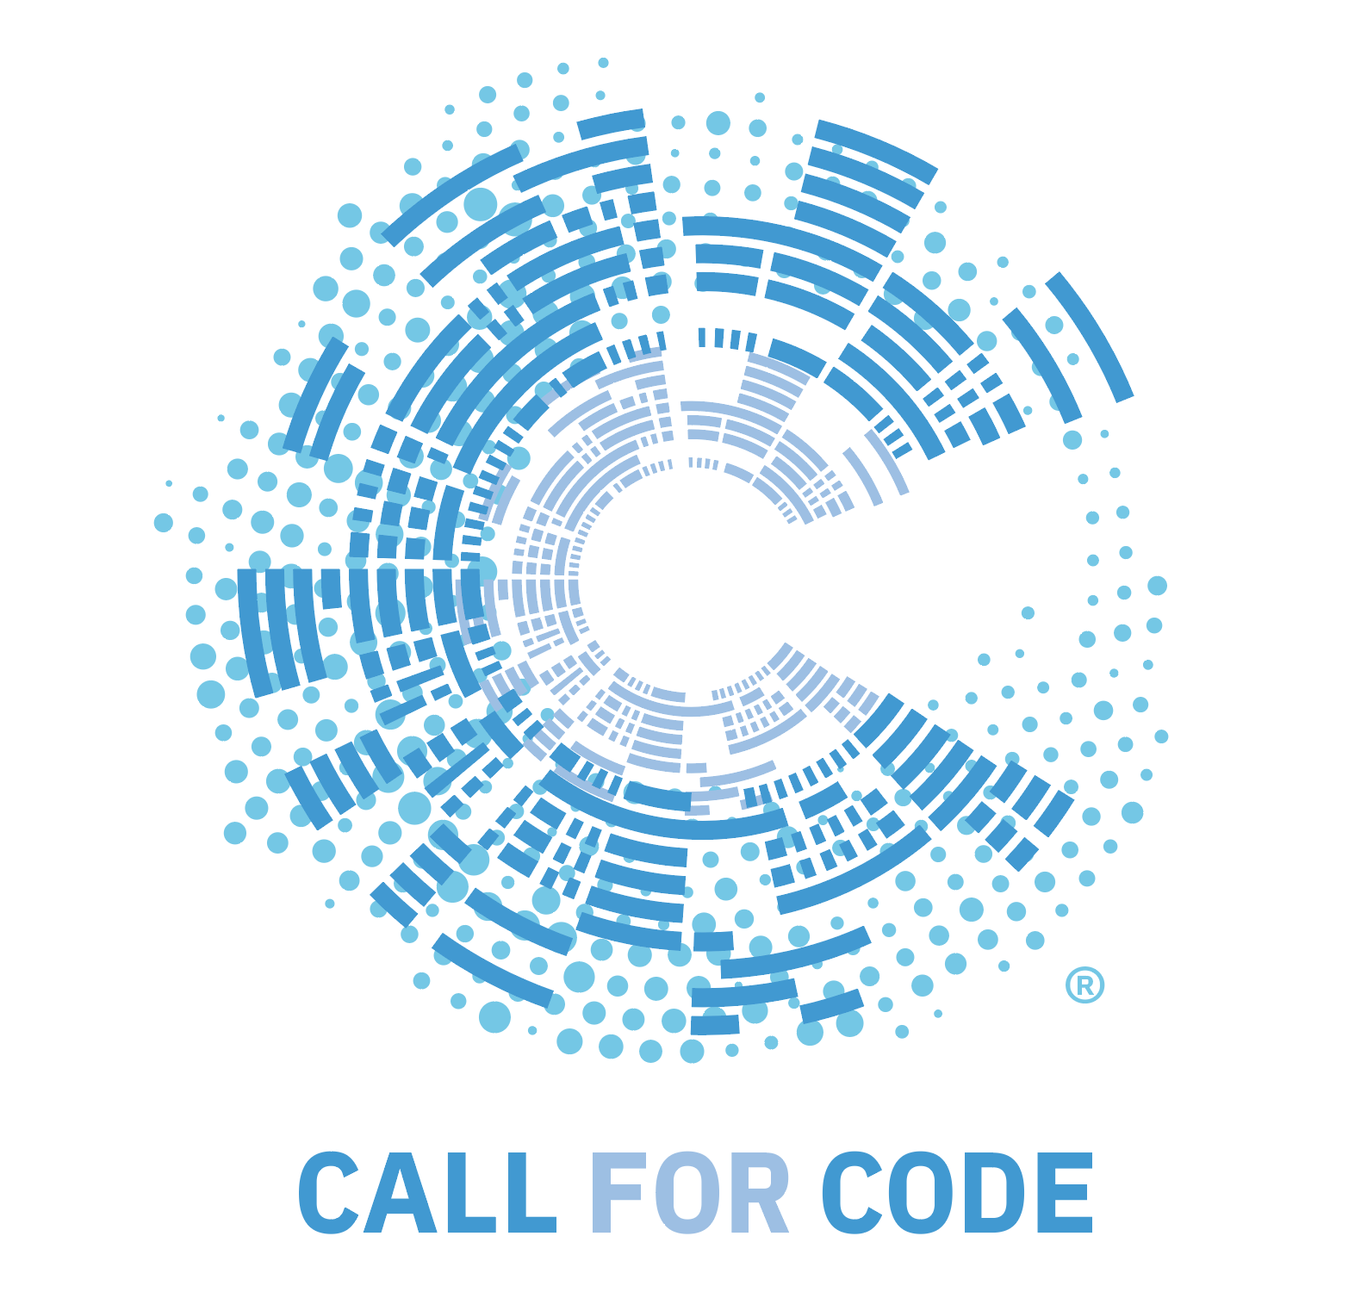
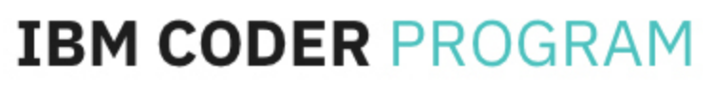




Stay Connected and continue coding !
Call for Code 2019
https://callforcode.org/
IBM Coder Platform
https://ibmcoders.influitive.com/
Code & instructions available here https://github.com/IBMDevConnect
Mumbai : https://www.meetup.com/Cloud-Mumbai-Meetup/
Hyderabad: https://www.meetup.com/Hyderabad-Cognitive-with-Cloud
Bangalore : https://www.meetup.com/IBMDevConnect-Bangalore
Chennai:
https://www.meetup.com/Chennai-CodeWeekend-Meetup/
Delhi NCR: https://www.meetup.com/IBM-cloud-developers-ecosystem-Delhi-NCR/
Check out the code patterns
https://developer.ibm.com/patterns/
Join our Slack team and stay in touch with the experts
https://ibmdevconnect.slack.com
Send in your request to - http://ibm.biz/slackrequest

